Slide 1
java
•
Java is a programming language originally developed by James Gosling at Sun Microsystems.
•
The language derives much of its syntax from C and C+
+ but has a simpler object model and fewer low- level facilities.
•
Java applications are typically compiled to byte code (class file) that can run on any Java Virtual
Machine (JVM) regardless of computer architecture.

Slide 2
Virtual machine
•
A virtual machine is a layer of abstraction that gives a program one simplified interface for interacting with a variety of physical computers and their operating systems.

Slide 3
Java virtual machine
•
As the name indicates, JVM is not a real hardware machine but a software layer which resembles an hardware platform.
•
JVM converts Java byte code into machine language and executes it.
•
The byte code can be executed on any platform where there exist JVM.

Slide 4
•
JVM‘s are available for many hardware and software platforms.
•
The use of the same byte code for all JVM’s on all platforms allows Java to be described as a "write once, run anywhere" programming language.
•
Thus, the JVM is a crucial component of the Java platform.

Slide 5
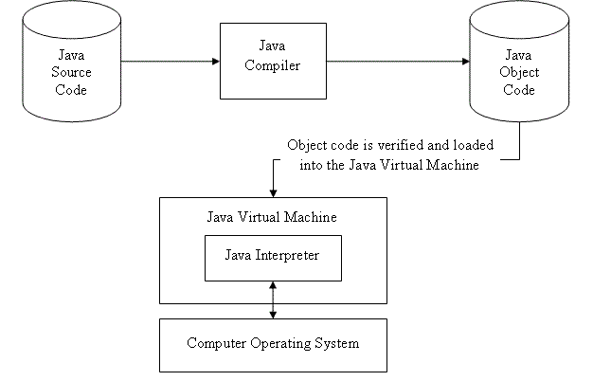
Diagram of JVM

Slide 6
Components of JVM
Byte code verifier
Class loader
Execution engine
Garbage collector

Slide 7
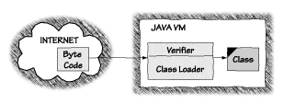
Byte code verifier
•
As the name suggests, bytecode verifier is used to verify the bytecode.
•
Bytecode verifier checks for unusual code.
•
Byte code verifier is a crucial component for security.

Slide 8
Class loader
•
Class loader loads java classes into java virtual machine.
•
All Java virtual machines include one class loader that is embedded in the virtual machine.
•
The main feature of the class loader is that JVM. doesn’t need to have any knowledge about the classes that will be loaded at runtime.
•
Class loader reads bytecode and creates the instance of java.lang.class.

Slide 9
Execution engine
•
The execution engine helps JVM to convert bytecode into machine code.
•
It has two parts:
Interpreter
Just-in-time-interpreter
•
Execution engine is responsible for executing the instructions contained in the methods of loaded classes.

Slide 10
Garbage collector
•
Garbage collection is the process of automatically freeing objects that are no longer referenced by the
program.
•
It periodically check for the object on heap , whose link is broken so it can collect garbage from heap.
•
Garbage collection relieves java programmer from memory management.

Slide 11
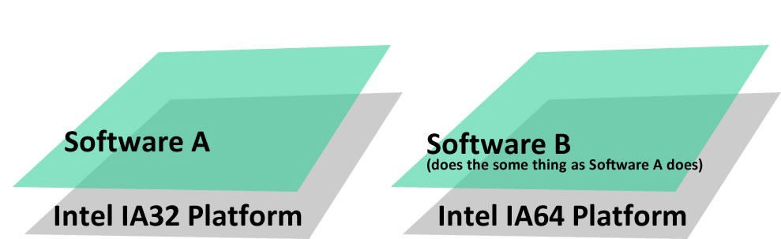
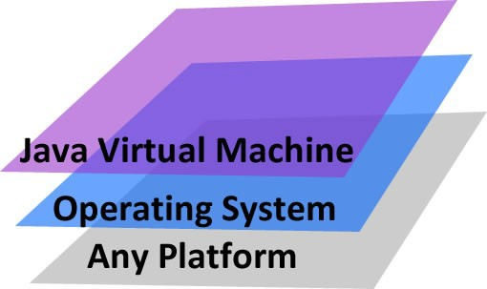
Comparison of JVM
Other software:
JVM:

Slide 12
•
Java Virtual Machine (JVM) is platform independent, meaning it can run on different Operating Systems (OS) like Windows or UNIX.
•
JVM does not really exist but is created within another environment.
•
As long as a JVM is available natively to a system, a Java program can run in the system.
•
The JVM stands on top of the operating system (OS), which means it is independent of the OS.

Slide 13
Advantages
Security
Cross Platform
Disadvantages:
Speed
Platform Specific Features

